Slide 1

Tomato Tigers
Henry Gao, Alexandra Iotzova, Katya Kurchin, Henry Mitchell, Xavier Pierce, Nicholas Ueki
Notes:
Hi everyone. We are the tomato tigers. I am Henry Gao.

Slide 2
Overview
What
Who
Why
How
What problem this product tries to solve
Who will be using this product
Why users choose this product
How this product works
Notes:
Our presentation is divided into four sections: what, who, why and how. Let’s get started!

Slide 3
What it does - Introduction
Our product forms effective teams by creating a social media like platform tailored to this context
Instead of relying on static surveys, or discussion boards, you will have access to a dynamic and user friendly platform designed to facilitate these connections
Groups are formed using our smarter algorithm
This network is made up of student profiles (Nodes) connected by their relationships (Edges)

Slide 4
What this does - Purpose Statement
The purpose of this software is to create a tailored social platform for CS 370 students to enhance team-building, resulting in stronger project outcomes. By leveraging a standard graph, composing of nodes and edges, the platform will serve as the hub for team member information. Restricting its use to this class will inform its design and allow for benefit from class feedback; our experiences will also guide its development.

Slide 5
What this does - visual representation
Group A
Susan
Group B
Graig
Michael
Group C
Sarah
Unassigned
Jesse
Earvin
Bob
Alice
Larry
Dennis
Mary
Candice
Isabel

Slide 6
Who Needs This - Intended Users
Students:
Primary users of the program
Creating a group is difficult, a compatible one more difficult
Tailored to personal interests, skill sets, etc.
Professors:
Utilize the program to facilitate better communication
Provide a stepping stone without direct involvement

Slide 7

Why need this - Evidence
After I submitted the survey on canvas, I wanted to add more information, but I could not update my answer.
I was interested in working with a student, but I did not have his contact information and had to email him.
During registration process, I could not know whether a person had found a group or not.
A student from section 3
A student from section 2
A student from section 3
Notes:
After deciding the project idea, we talked to a few students in both sections, and here are some quotes we collected.
These evidence shows that there is a need for a product that can help students find teammates for group projects.

Slide 8
Why not others - Existing Solutions (Team-Maker)
A Purdue University tool for criterion-based team assignment intended for instructors only
offers a list of criteria from which instructors can choose when forming teams; custom criteria are allowed
scores how well each team fits the instructor’s criteria and maximizes the score of the worst-fitting team
Criteria can be changed and the application run again to form different teams
Students cannot form their own team and the instructor has to assign the groups

Slide 9



Why not others - Existing Solutions (Social Media)
Allows users to create group chats
Allows users to send and search messages
Pros
Offers direct and group messaging system
Allows dynamic information update
Cons
Students have to search up profiles
Complicated system with many groups
Notes:
Another existing solution is social media. Yes, social media can help us find teammates, though it is not a good choice. Social media allows users to create group chats, send and search messages. The advantage is that it offers direct and group messaging systems and allows dynamic information update. However, students would have to search others’ profiles and the system can be complicated when too many groups are created.

Slide 10


Why not others - Existing Solutions
Google Classroom & Canvas
A group messaging platform for study groups or project teams
Teams are manually or randomly assigned by the instructor.
Students have to be registered to the classroom.

Slide 11
Why TeamForge - Benefits
Profile building
Expansive profiles
Make changes and/or revisions to existing profile
Tag specific interests
Organization
Easily find mutual interests through tags
Removes the need to read blocks of text
Mutual member interests accelerates group creation
Classroom tool
Communication
Centralized: No need to search for contact information
Direct messaging from profiles encourages communication

Slide 12
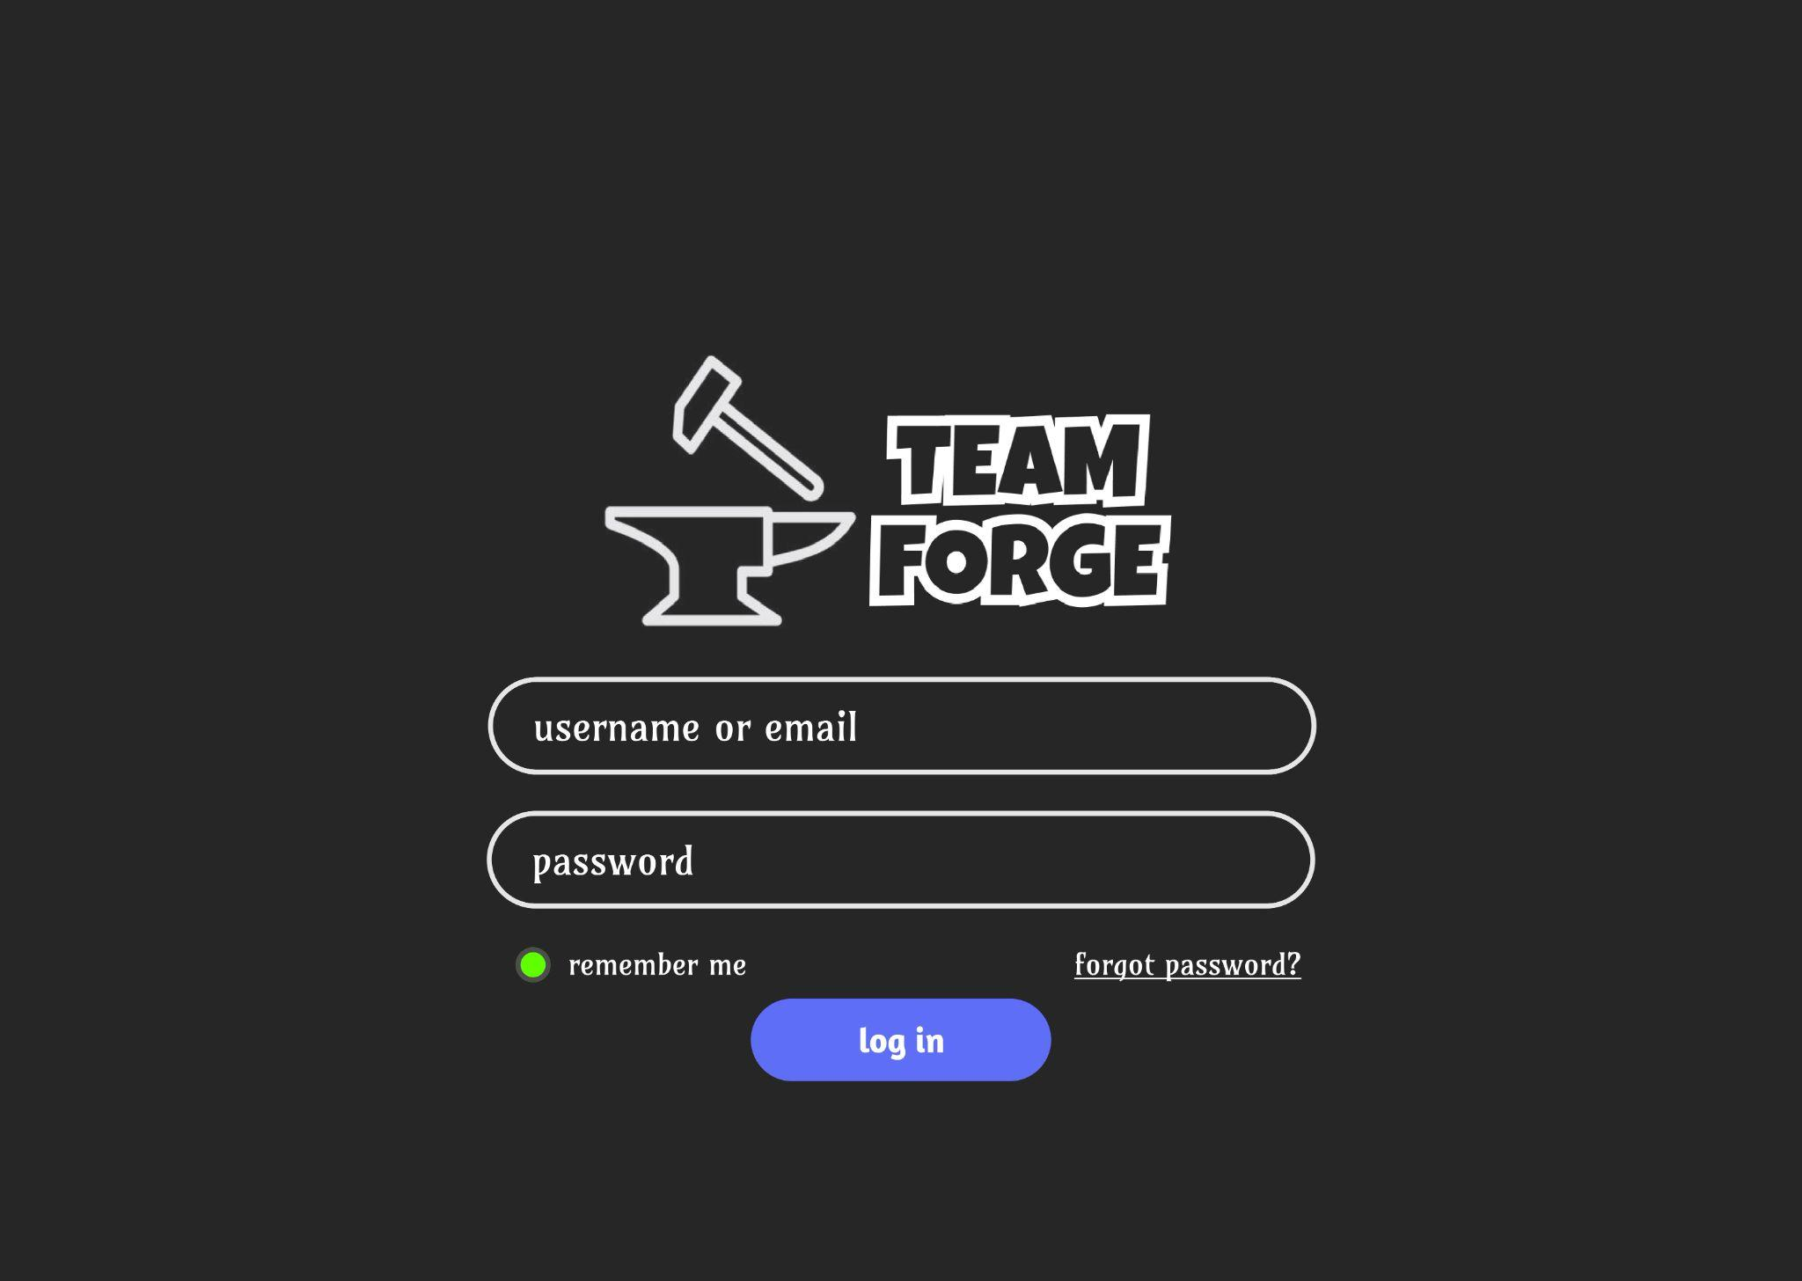
How this works - Prototype

Slide 13
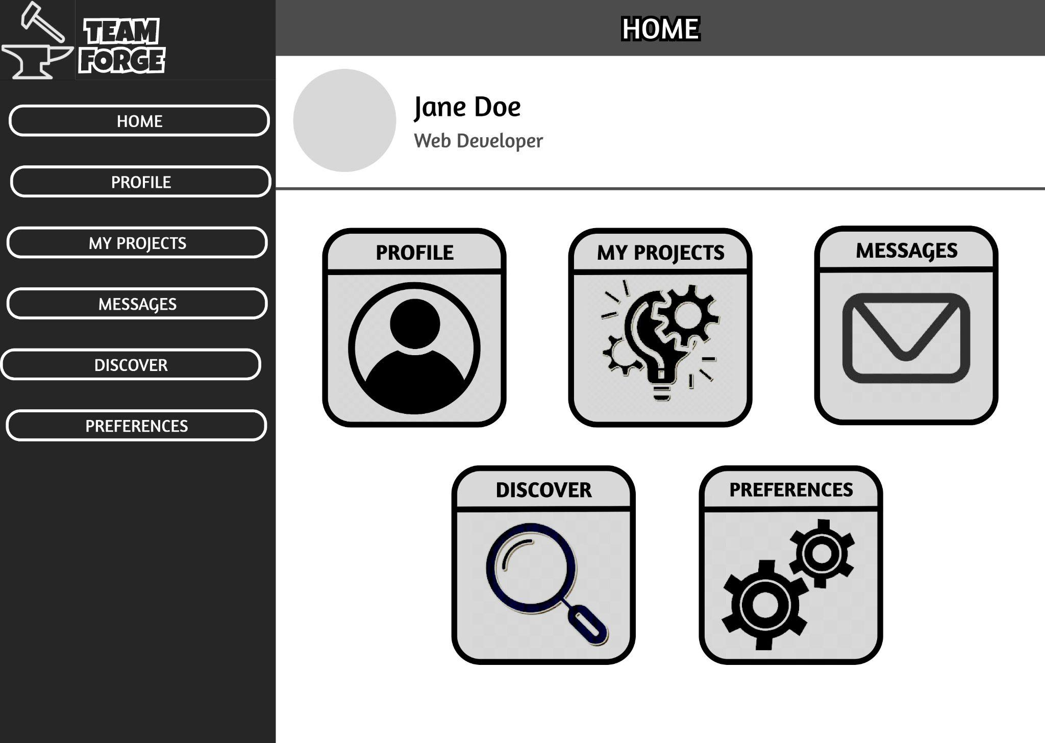
How this works - Prototype

Slide 14
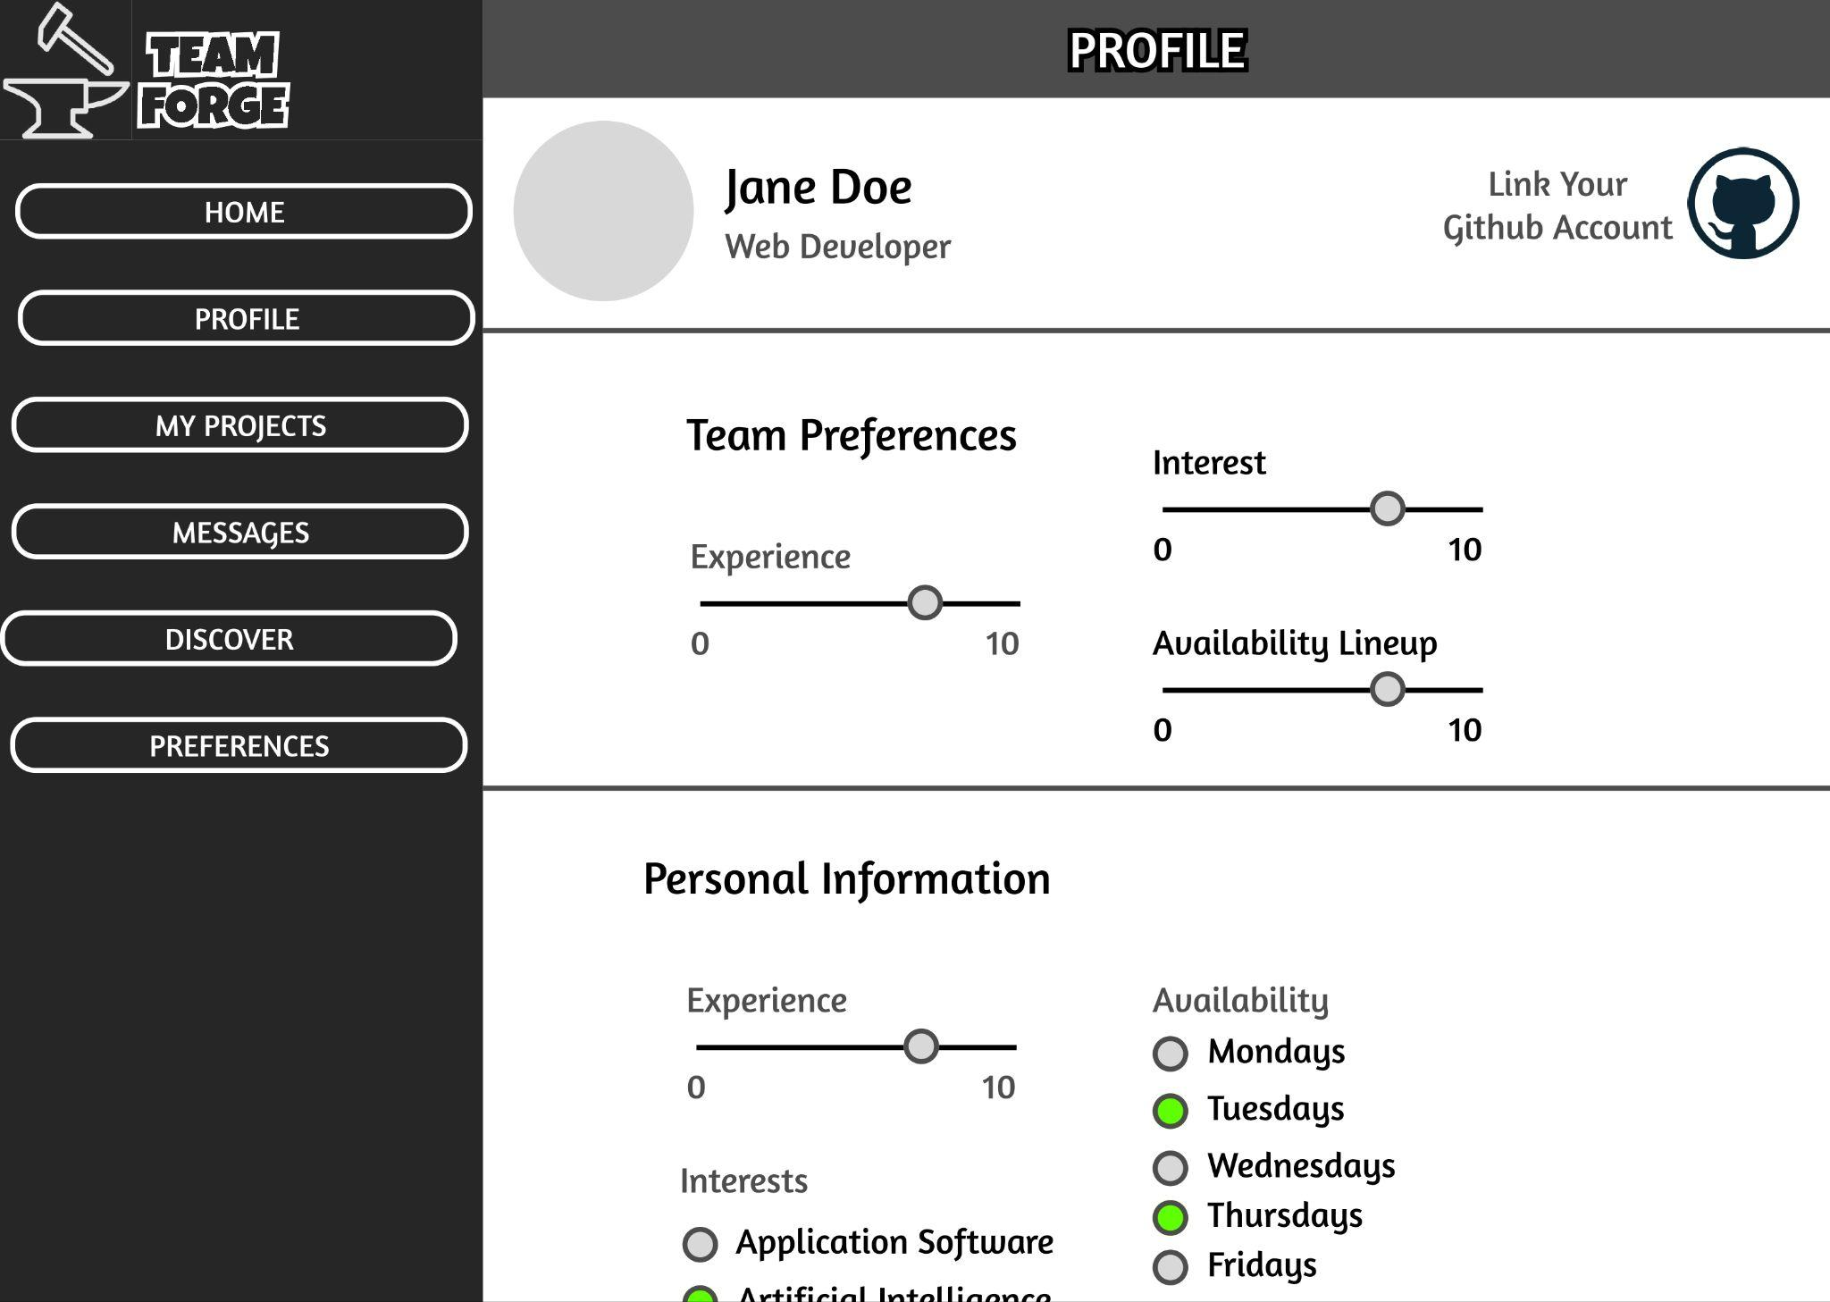
How this works - Prototype

Slide 15










How this works - Structure & Technology
User Interface (Frontend)
Git
GitHub
Application Server (Backend)
Database & Deployment
Notes:
Here is the structure of our product and the technology we will be using. The product is divided into the frontend, backend and database. In the frontend, we will use HTML, CSS and Javascript. In the backend, we will use java and spring boot. We are also going to use AWS and MySQL for database. Docker and Kubernetes will be used to manage the components. At the same time, we will use git and github for version control.

Slide 16
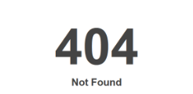
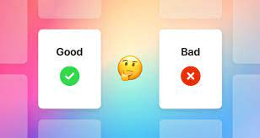
How this works - Potential Risks
Design risks:
Unattractive core functionality
Too complex to use
Implementation risks:
Usage of outdated components
Integration with third party systems
Unfamiliar with required technology
Possibility of website crash
Data consistency

Slide 17


How this works - Additional Features
During the development process we might consider adding:
Communication between students or within groups
Integration with the Emory Login system
User authentication with OAuth 2.0
Link to a student’s github account
As a member, I want to be able to go to others' github account page, so that I can know more about my potential team members.
As a member, I want to be able to login with my google account, so that the login process is more convenient.

Slide 18
How this works - Sustainability
Efficient Time Management
The platform streamlines team-building, saving classroom time and allowing students to dive into project work sooner.
Resource Efficiency
Focuses only on the relevant audience.
Fostering Social Sustainability
Prioritizes building connections and creating a welcoming environment.

Slide 19
Thank you for listening!

Slide 20
Q&A Time
We look forward to your opinions and suggestions!

